Slide 1



microservices in a MEGA overview
Alex Thissen
Lead Consultant
athissen@xpirit.com
https://www.xpirit.com
@alexthissen

Slide 2

Agenda
Introduction: the pains and the promises
Concepts of microservices architectures
Development
Deployment
Wrapup
Questions & Answers

Slide 3
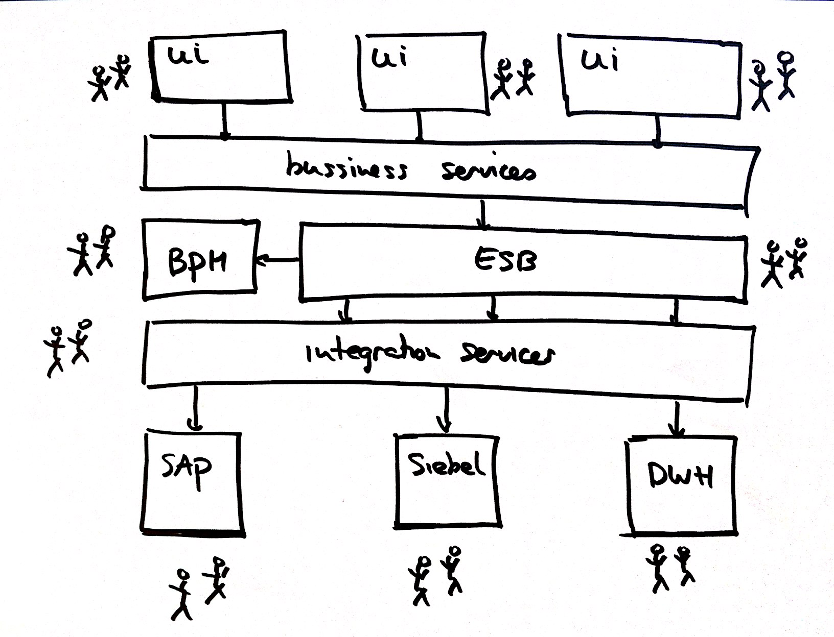
Traditional enterprise architectures

Slide 4



About monoliths

Slide 5
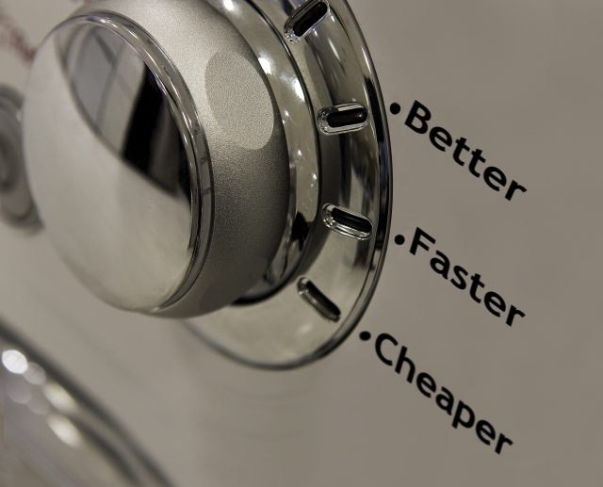
Valued business drivers
Better
Resilient
Cheaper
Test effort
Cost of maintaining
Faster
Deployment
Execution
Change
Technology choice

Slide 6
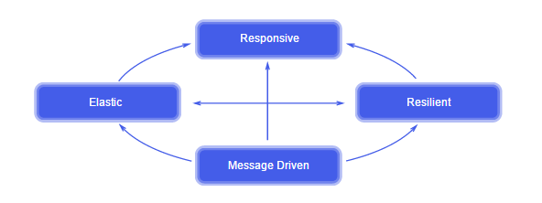
Trends in software development
Platform as a Service
Autonomous teams
Continuous Delivery
Agile Organization
Reactive manifesto
Notes:
http://www.reactivemanifesto.org/

Slide 7

Definitions of microservices
Small and focused on doing one thing well
Autonomous
“Loosely coupled service oriented architecture with bounded contexts” Adrian Cockcroft (Netflix)
“… services are independently deployable and scalable, each service also provides a firm module boundary, even allowing for different services to be written in different programming languages.” Martin Fowler (Thoughtworks)
“SOA done right” Anonymous

Slide 8


Size matters (not)
It’s not about lines of code used
Small enough to
Be handled by a single team
Not feel “big”

Slide 9

Chosen strategy
Obtain simplicity by adding complexity

Slide 10
Benefits
Heterogeneous technology landscape
Resilience against failure
Selective scaling
Deployment of smaller pieces with lower risk
Alignment with organization
Ownership with teams
Composability
Replaceability

Slide 11
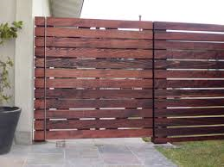
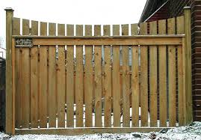
From horizontal to vertical
Change your approach to vertical partitions
Organized by logical cohesion
Teams own layers spanning domains
Unified technology choice
Modeled after organization’s domains
Owned by team
Top to bottom
Isolated from each other as much as possible

Slide 12
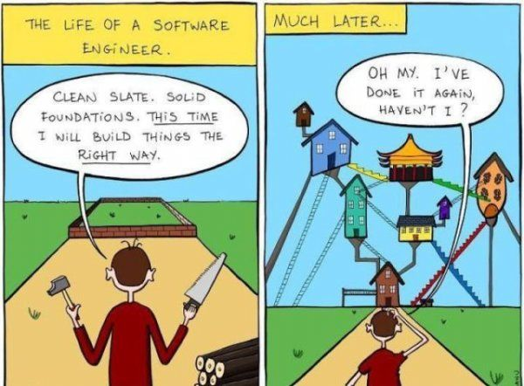
Getting started

Slide 13
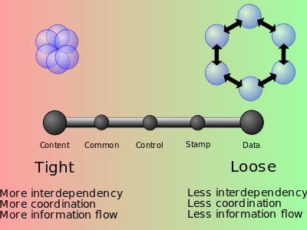
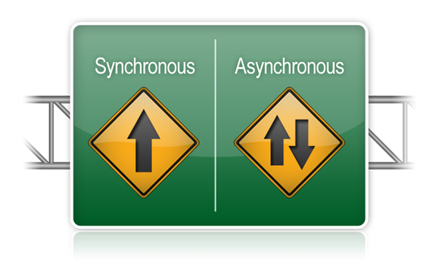

Achieving your goals
Apply microservices’ principles and practices:
Low coupling and high cohesion
Asynchronous over synchronous
Choreography over orchestration

Slide 14
Freedom of choice
Frontend integration
Social
Report
Product
Graph
Blob
Document

Slide 15
Low coupling
Measurement of dependency between two components
Expressed as sensitivity towards propagation of changes and errors
No Coupling
Components are completely insensitive to changes and errors in other components.
Low Coupling
Error and changes seldom propagate errors and changes to dependent components
High Coupling
Errors and changes in one component almost always propagate to other components

Slide 16
High cohesion
Degree to which parts of a module belong together
Levels:
Coincidental cohesion (worst)
random
Logical cohesion
same in nature
Temporal cohesion
executed at a particular time
Procedural cohesion
part of fixed execution sequence
Informational cohesion
operating on the same data
Sequential cohesion
Output of one is used as input by another
Functional cohesion (best)
contributing to a single task
Notes:
Coincidental cohesion (worst)
Coincidental cohesion is when parts of a module are grouped arbitrarily; the only relationship between the parts is that they have been grouped together (e.g. a “Utilities” class).
Logical cohesion
Logical cohesion is when parts of a module are grouped because they are logically categorized to do the same thing, even if they are different by nature (e.g. grouping all mouse and keyboard input handling routines).
Temporal cohesion
Temporal cohesion is when parts of a module are grouped by when they are processed - the parts are processed at a particular time in program execution (e.g. a function which is called after catching an exception which closes open files, creates an error log, and notifies the user).
Procedural cohesion
Procedural cohesion is when parts of a module are grouped because they always follow a certain sequence of execution (e.g. a function which checks file permissions and then opens the file).
Communicational/informational cohesion
Communicational cohesion is when parts of a module are grouped because they operate on the same data (e.g. a module which operates on the same record of information).
Sequential cohesion
Sequential cohesion is when parts of a module are grouped because the output from one part is the input to another part like an assembly line (e.g. a function which reads data from a file and processes the data).
Functional cohesion (best)
Functional cohesion is when parts of a module are grouped because they all contribute to a single well-defined task of the module (e.g. Lexical analysis of an XML string).

Slide 17
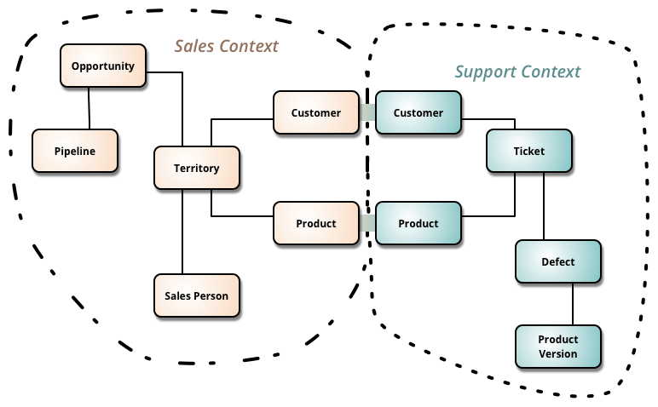
Bounded contexts

Slide 18

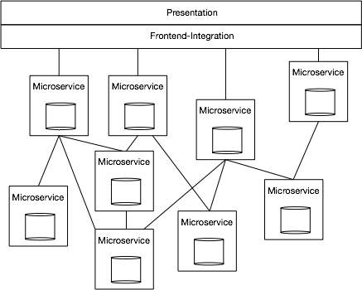
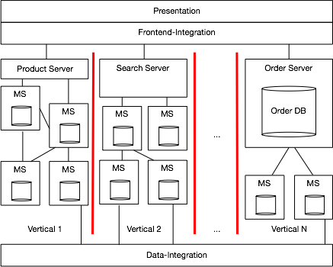
Example: otto.de

Slide 19
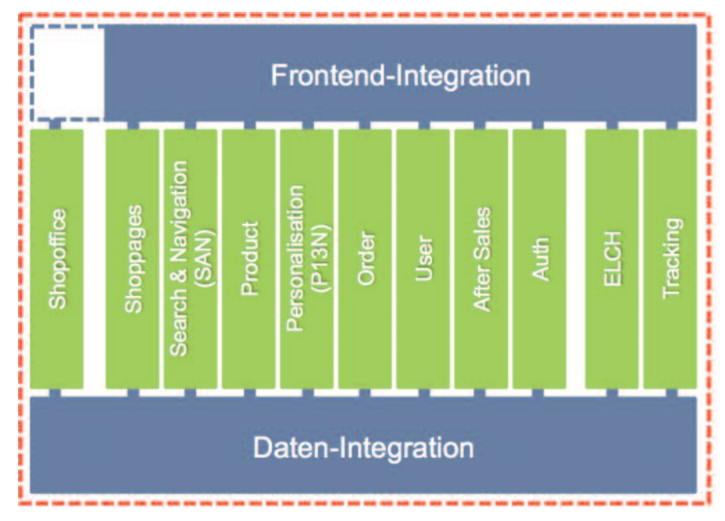
Example Microservices architecture - otto.de
11 verticals
Autonomous teams around a component
Independently deployable
Own data storage
Source: http://ottodev.files.wordpress.com/2013/11/teile-und-herrsche-kleine-systeme-fc3bcr-groc39fe-architekturen.pdf
Notes:
A complete new website Architecture
Drivers:
Increased volume on the website (number of visitors, customers, sales)
Increased Size of the system and development team (Over 100 people, 100 KLOC)
How to organize the teams and the system optimally?
The came up with a microservices architecture avant le lettre, turning their monolitic application into 11 independent runtime components.

Slide 20
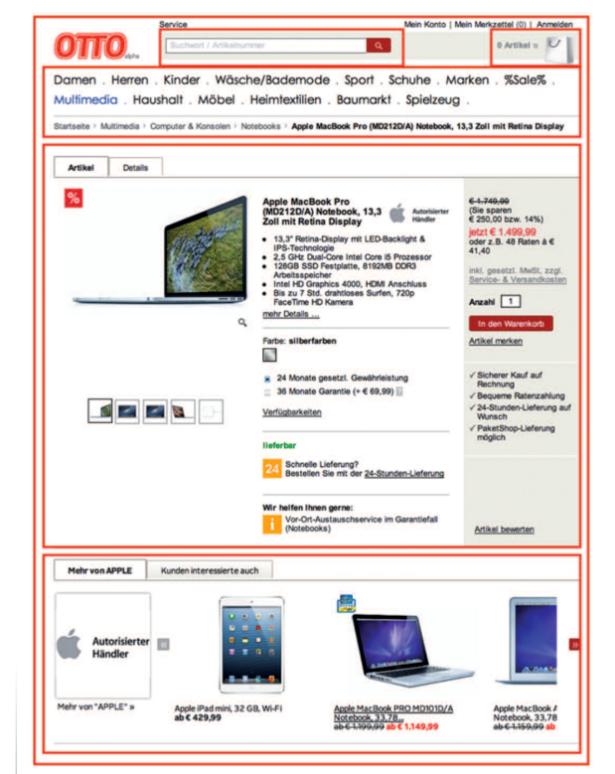
Example Microservices architecture - otto.de
Each with own UI (on website)
Well defined interfaces
No shared code or state
REST interfaces for each vertical
Pull based data replication
Front end integration (JavaScript/Edge includes)

Slide 21
Event Driven Architecture
Systems keep their own state
Events are used to notify changes
Systems use events to replicate data
Each system will have it’s own database
Downsides:
Latency in data changes
No central control of business logic

Slide 22
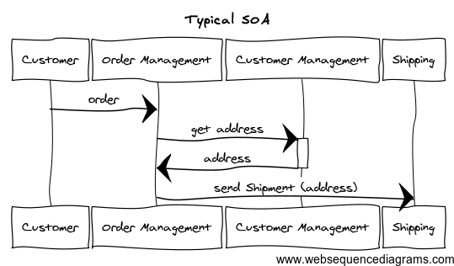
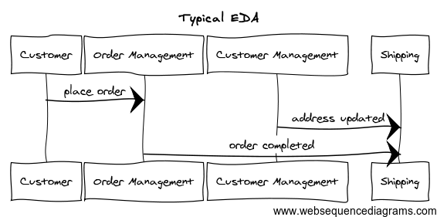
Comparing SOA and EDA

Slide 23
Microservice concerns
Tooling
Configuration
Discovery
Routing
Observability
Datastores
Operational: Orchestration and Deployment Infrastructure
Development: languages and container
Notes:
From: State of the Art in Microservices by Adrian Cockcroft (Battery Ventures)
https://www.youtube.com/watch?v=nMTaS07i3jk

Slide 24
Possible Microservice architecture
UI is resilient to failing or unavailable services
Teams own UI as well
User Interface Integration
Mostly resource based REST APIs
UI
UI
UI
Choose appropriate technology per service
Async calls to other services
MS1
MS2
MS3
MS4
Events
Commands
Elements of Event Driven Architecture
MS4
(Don’t) share database schema
per partition
All inter-service communication is asynchronous

Slide 25
Cross-service coupling
Smart endpoints, dumb pipes
No intelligent middleware
Technologies to look at:
Queues (Azure, MSMQ, WebSphereMQ , ...)
Service Bus (NServiceBus, Azure ServiceBus, ...)
Language neutral data serialization (Google Protocol buffers, Apache Thrift)

Slide 26
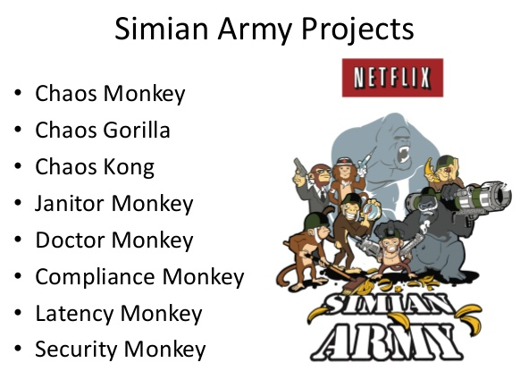

Designed for failure
Services can and will fail: prepare!
Do not rely on another service’s availability
Introduce features in your app to deal with it
Test under stress and with failing services

Slide 27
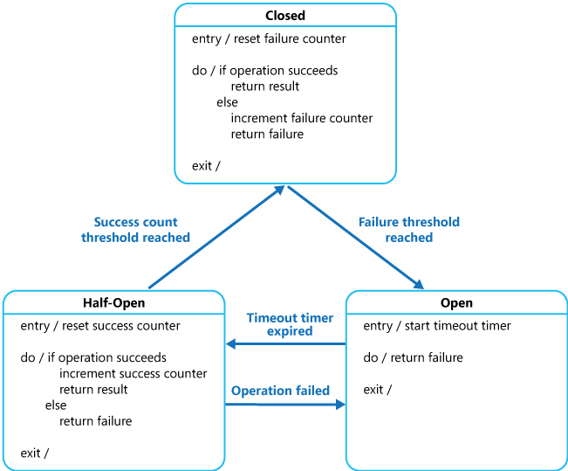
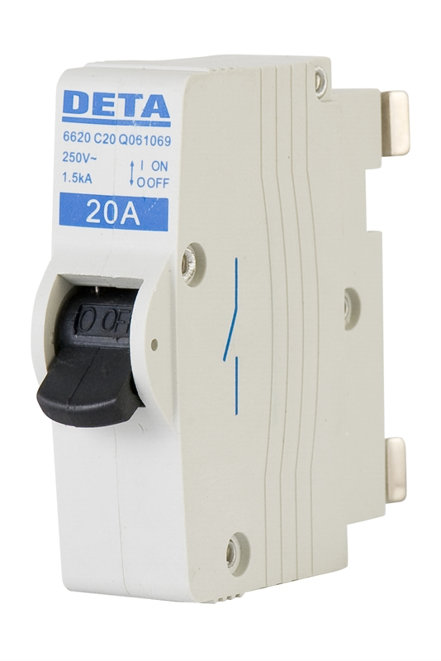
Circuit breaker pattern
Design pattern to deal with failing calls
Handles retries and giving up
Combines with
Retry pattern
Endpoint Health monitoring

Slide 28
Demo
XPark
Theme: Parking garages
User Interface Integration
Reporting
Capacity
UI
ParkingService
Availability
ParkingFull event

Slide 29
Adopting DevOps practices
Allow individual services to be built and deployed independently
Continuous integration (CI)
Continuous delivery (CD)

Slide 30











Services up and running
OS
Virtual machines
PaaS
Container runtimes

Slide 31
Hosting your services
Host
Host
Host
Host
Micro Service
Micro Service
Application container
Micro Service
Micro Service
Micro Service
Micro Service
Micro Service
Micro Service
Host
Host
Micro Service
Micro Service
Hosting in application container
High density hosting
One service per host

Slide 32
Summary
Microservices architecture is:
Collection of current trends, patterns and practices
Adding complexity for simplicity
No silver bullet or golden hammer
Suitable for modern business oriented apps
A journey to achieve benefits

Slide 33


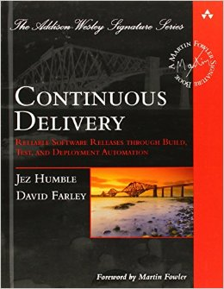
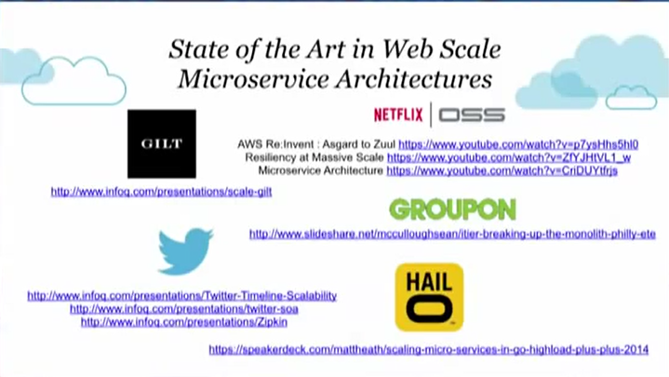
Further reading
Microservice architecture, Sam Newman
Domain Driven Design, Eric Evans
Microservices, Martin Fowler
Continuous Delivery, Jez Humble

Slide 34


